Slide 1
Teleworking Tips May 12-14, 2020 Presenter: Jason Hetterle

Slide 2
agenda
Welcome
Statistics on Teleworking
18 Tips From Inc.com
Tech Tools
Software
Hardware
What have you done?
What’s working (or not)
Q&A

Slide 3
Welcome to Tech talk
Events:
Teleworking Tips → May 12 & 14
O365 Mail/Security → May 19 & 21
Canvas → May 26 & 28
Misc:
Website – Recordings/Presentations/Schedule
Etiquette

Slide 4
Teleworking Statistics
Q: How many employees work from home? -2018

Slide 5
Teleworking Statistics
Q: How many employees work from home? -2018
A: 5 million + (173% growth since 2005)

Slide 6
Teleworking Statistics
Q: How many employees work from home? -2018
A: 5 million + (173% growth since 2005)
Q: How many people could telework?

Slide 7
Teleworking Statistics
Q: How many employees work from home? -2018
A: 5 million + (173% growth since 2005)
Q: How many people could telework?
A: 62% of employees say they could.

Slide 8
Teleworking Statistics
Q: How many employees work from home? -2018
A: 5 million + (173% growth since 2005)
Q: How many people could telework?
A: 62% of employees say they could.
Q: How many people want to telework?

Slide 9
Teleworking Statistics
Q: How many employees work from home? -2018
A: 5 million + (173% growth since 2005)
Q: How many people could telework?
A: 62% of employees say they could.
Q: How many people want to telework?
A: 80% say they want to.

Slide 10
Teleworking Statistics
Q: How many employees work from home? -2018
A: 5 million + (173% growth since 2005)
Q: How many people could telework?
A: 62% of employees say they could.
Q: How many people want to telework?
A: 80% say they want to.
Q: What are the demographics of teleworkers?

Slide 11
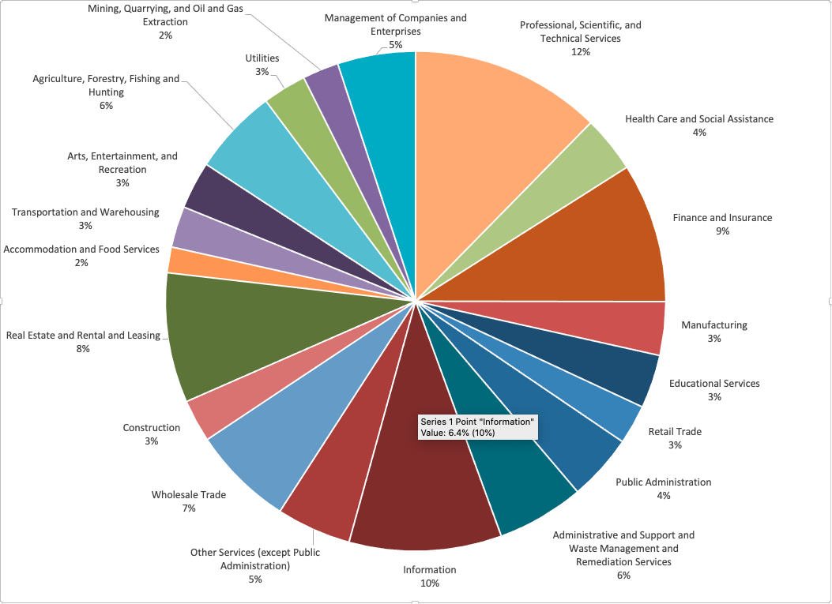
Teleworking Statistics
Q: What are the demographics of teleworkers?

Slide 12
Teleworking Statistics
Q: Why would you want to teleworker?

Slide 13
Teleworking Statistics
Q: Why would you want to teleworker?
It reduces cost for workers - Remote workers can save about $7,000 a year on average
It reduces stress - Figures from OWLLabs in 2019 show that people who work from home at least once a month are 24% more likely to report feeling happier.
It prolongs careers - More than half of workers over age 50 are likely to be out of a job at some point in their career.

Slide 14
Teleworking Statistics
Q: Why would you want to telework?
It benefits the environment - Telecommuting’s environmental impact has been well-documented, from decreasing greenhouse gas emissions due to less commuting, to improving air quality, especially in urban areas.
It benefits personal and family relationships - Parents and caregivers who work remote, flexible schedules are often able to build their careers around time with their family members and taking care of loved ones, rather than squeezing in personal time around their jobs.

Slide 15
Teleworking Statistics
Caution:
Only 1 in 60 work from home opportunities are legitimate. The rest are scams.
Resources:
https://globalworkplaceanalytics.com/telecommuting-statistics
https://www.flexjobs.com/blog/post/stats-about-telecommuting-in-the-us/
https://remote.co/10-stats-about-remote-work/

Slide 16
Teleworking Tips - Inc.com
Identify what needs to get done every day and make do it.
Use the Cloud.
Get Dressed.
Don't let friends stop by.
Get out of the house.
Invest in creating a comfortable office.
Make a stoplight for family members.
Be clear about your working hours.
Pretend you're not home.

Slide 17
Teleworking Tips - Inc.com
Don't go to non-work appointments in the middle of the day.
Get in-person time with co-workers.
Use Zoom and Office 365.
Enjoy your flexibility.
Enjoy disruptions.
Stay out of the kitchen.
Buy a noise-cancelling headset with a mute button.
Check in with co-workers and the boss several times a day.
Make use of free or inexpensive communications technology.
https://www.inc.com/christina-desmarais/get-more-done-18-tips-for-telecommuters.html

Slide 18
Tech Tools - Software
Zoom – Brad Cushman
Office 365 – Joseph Andreason

Slide 19
Tech Tools - Hardware
Connection
Chair
Environment
Monitors
Alternative Options

Slide 20
What Have you done?????
What’s working??? or not

