Slide 1

Welcome! ctcLink Time and Leave training!

Slide 2
Topics to be covered:
Entering Time
Potential Questions about Entering Time
Entering Leave
Potential Questions about Entering Leave
Notes:
Come Back to this later

Slide 3
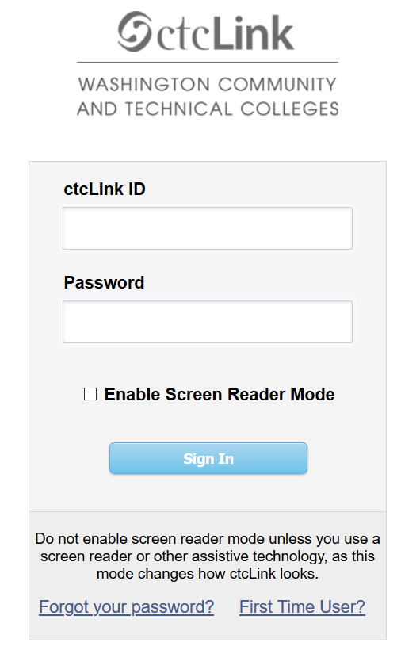

Employee Self-Serve to Time
GO TO THE LOG-IN PAGE: https://gateway.ctclink.us/
* Enter your new ctcLink ID
* Enter your password

Slide 4
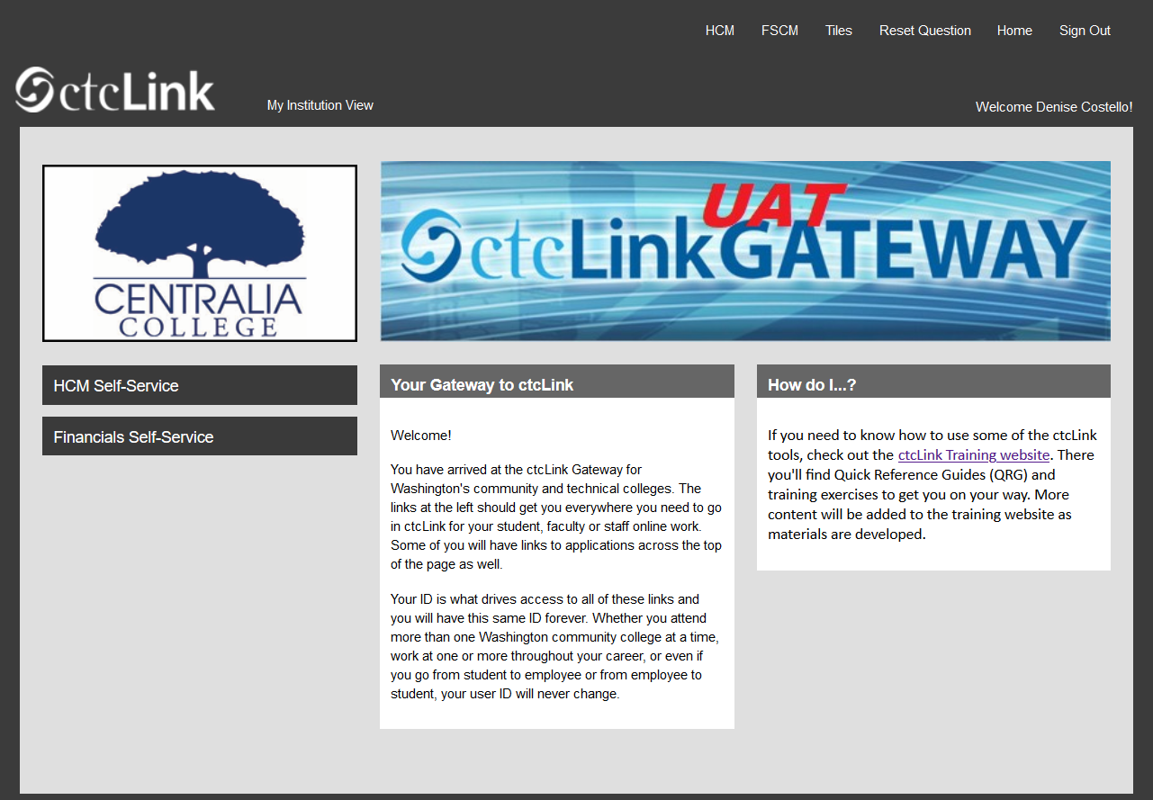
Employee Self-Serve to Time
  After hitting “Sign In”, you should arrive at a page like this.
  Click on “HCM” at the top
  right of the page.
  OR
  Click on the bar “HCM Self
  Service” at the left.
  “HCM” stands for
  Human Capital
  Management

Slide 5
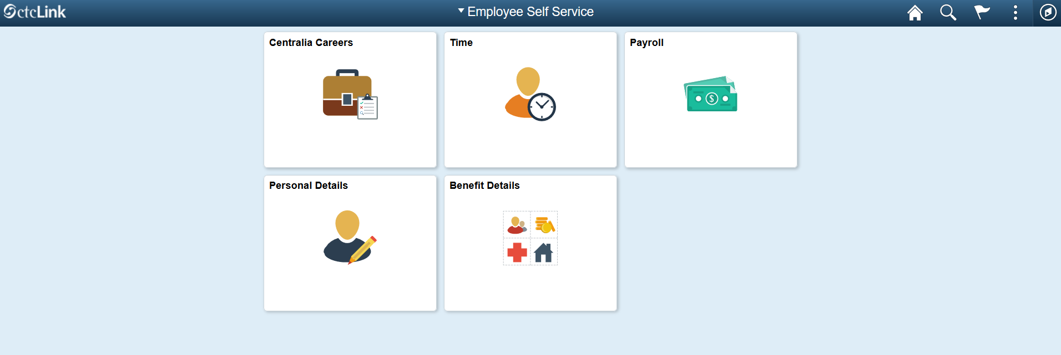
Employee Self-Serve to Time
  After clicking on HCM, a page like this will open
  Click the “time” tile on your homepage.
Notes:
*Notice there are a variety of tiles. Each person may have a different number of tiles
If you click on the Personal Details tile, you can check your name, address, contact details, emergency contact, etc.
Payroll = wage history, direct deposit information, W-2 info, tax withholding, etc.
Explore the tiles that you have access to after you activate your account.

Slide 6
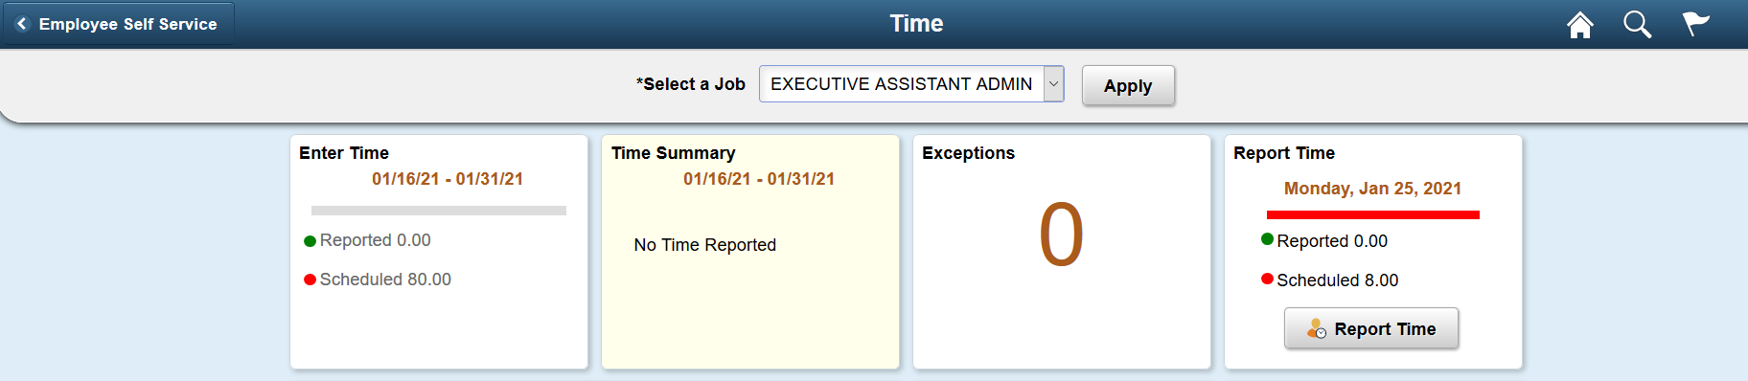


Behind the Time Tile
  You now have two options. You can “Enter Time” or “Report Time” on this page.
  Note: It is best practice to report time on a daily basis to
  ensure accuracy and completeness.
Note: It is best practice to report time on a daily basis to ensure accuracy and completeness.
**If you have (or have had) more than one job title, make sure you are entering time for the correct position.
Notes:
Which one would be easiest to use when reporting time daily?

Slide 7
Behind the Time Tile
The Enter Time tile shows the full time-period, with a summary of the number of hours reported and the number of hours scheduled. This is where you can go to add multiple days at one time.
The Report Time tile only shows today’s date, with the number of hours scheduled today and the number of hours reported. This is where you go to report one day at a time.
Notes:
Reporting time on a daily basis helps to ensure accuracy and completeness.

Slide 8
Behind the Time Tile
Two more points about “Report Time”:
*The Report Time tile is recommended for anyone using assistive technology.
*This is also the only option available if you are using ctcLink on a mobile device.
Notes:
Yes! You can log-in to ctcLink on your mobile device!

Slide 9
Report Time Tile
1. Select an option from the Time Reporting Code drop down menu, typically “Regular”
2. Enter the number of hours for that particular Time Reporting Code.
3. Click the Submit button
4. View your submitted hours. The total hours submitted for the day show in the section box 4
Notes:
The date appears at the top. Use the arrows to the left and right of the date to go back or forward a day and enter time.
#1 If you have not requested an absence and been approved by your supervisor then there will not be a reporting code available for you to report sick-leave or vacation, etc.
#2 Most of the time you are reporting one code and your full hours. Sometimes you may be reporting 01 Regular hours worked in addition to sick time or some other absence.
#2 if you are reporting 4 hours regular and 4 hours sick, you will repeat steps 1-4 for the same day

Slide 10
Report Time Tile
* Note: each day you enter time your supervisor will be notified and can go and approve time.
* There is no “SAVE” for later option!
Notes:
This means every day you hit submit, an email will be sent to your supervisor alerting them that you have submitted time for the day.

