Slide 1

Welcome! ctcLink Time and Leave training!

Slide 2
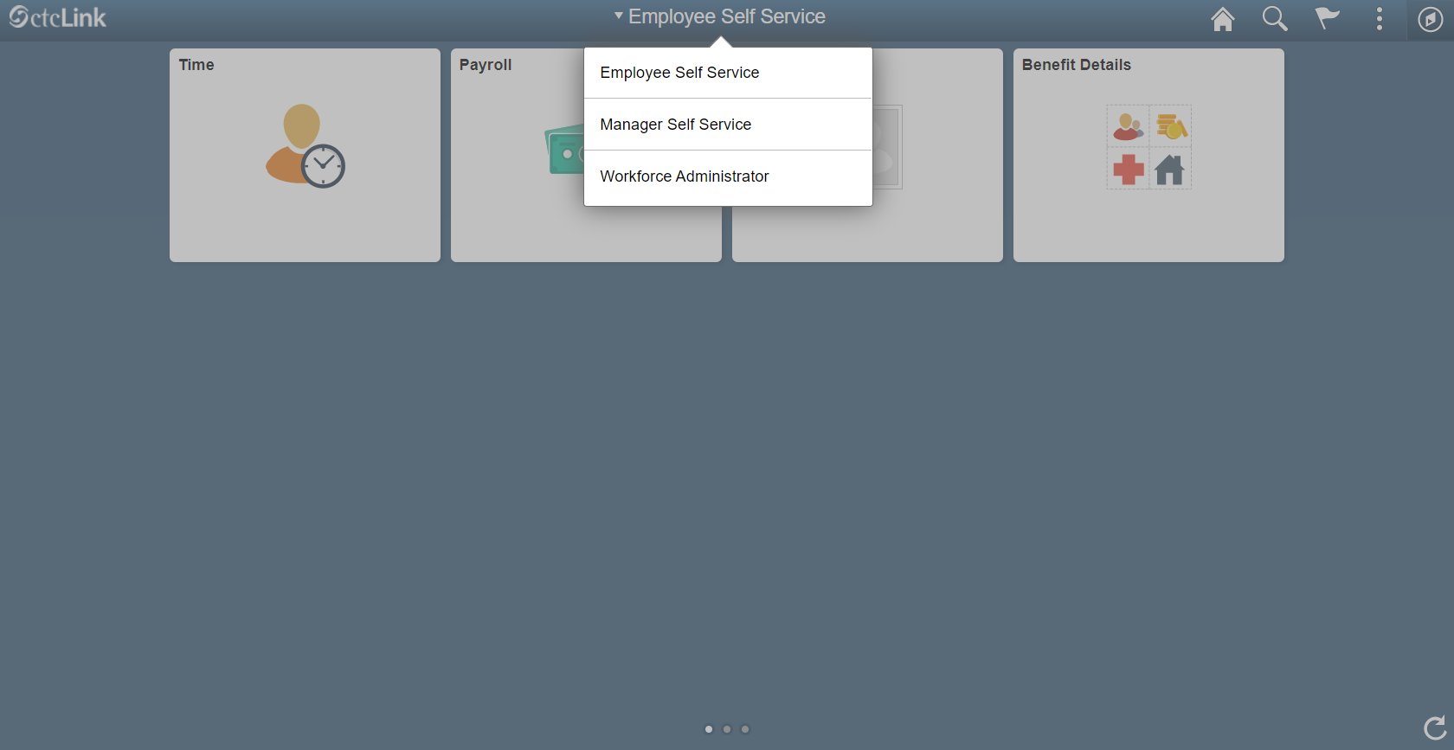
From Employee Self Service in HCM, Choose Manager Self Service:

Slide 3
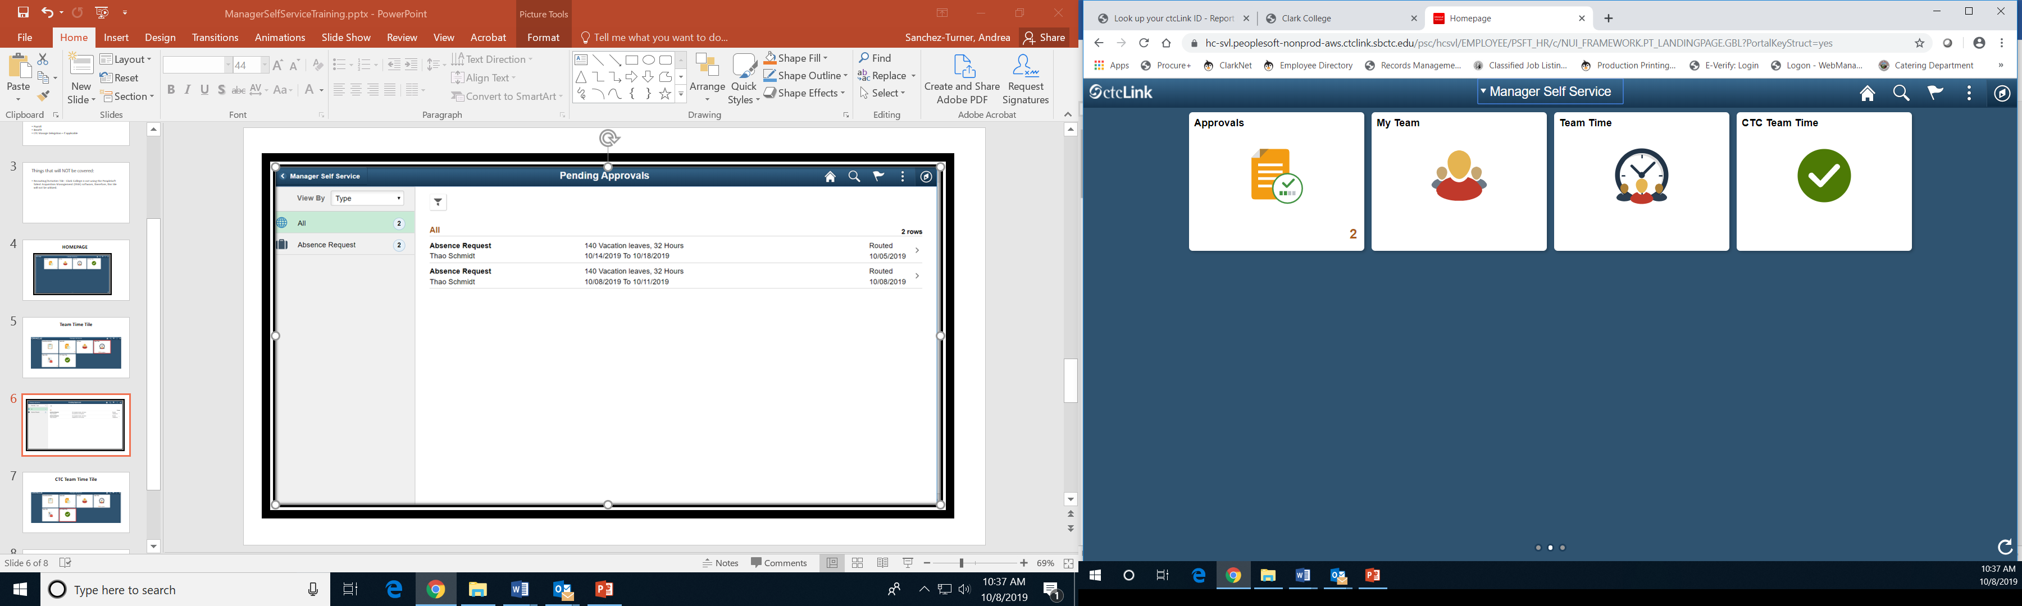
Manager Self-Service Homepage

Slide 4
Approvals Tile

Slide 5
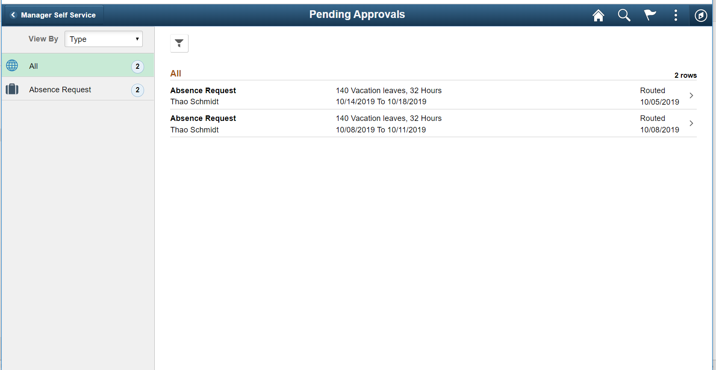

Slide 6
My Team Tile

Slide 7
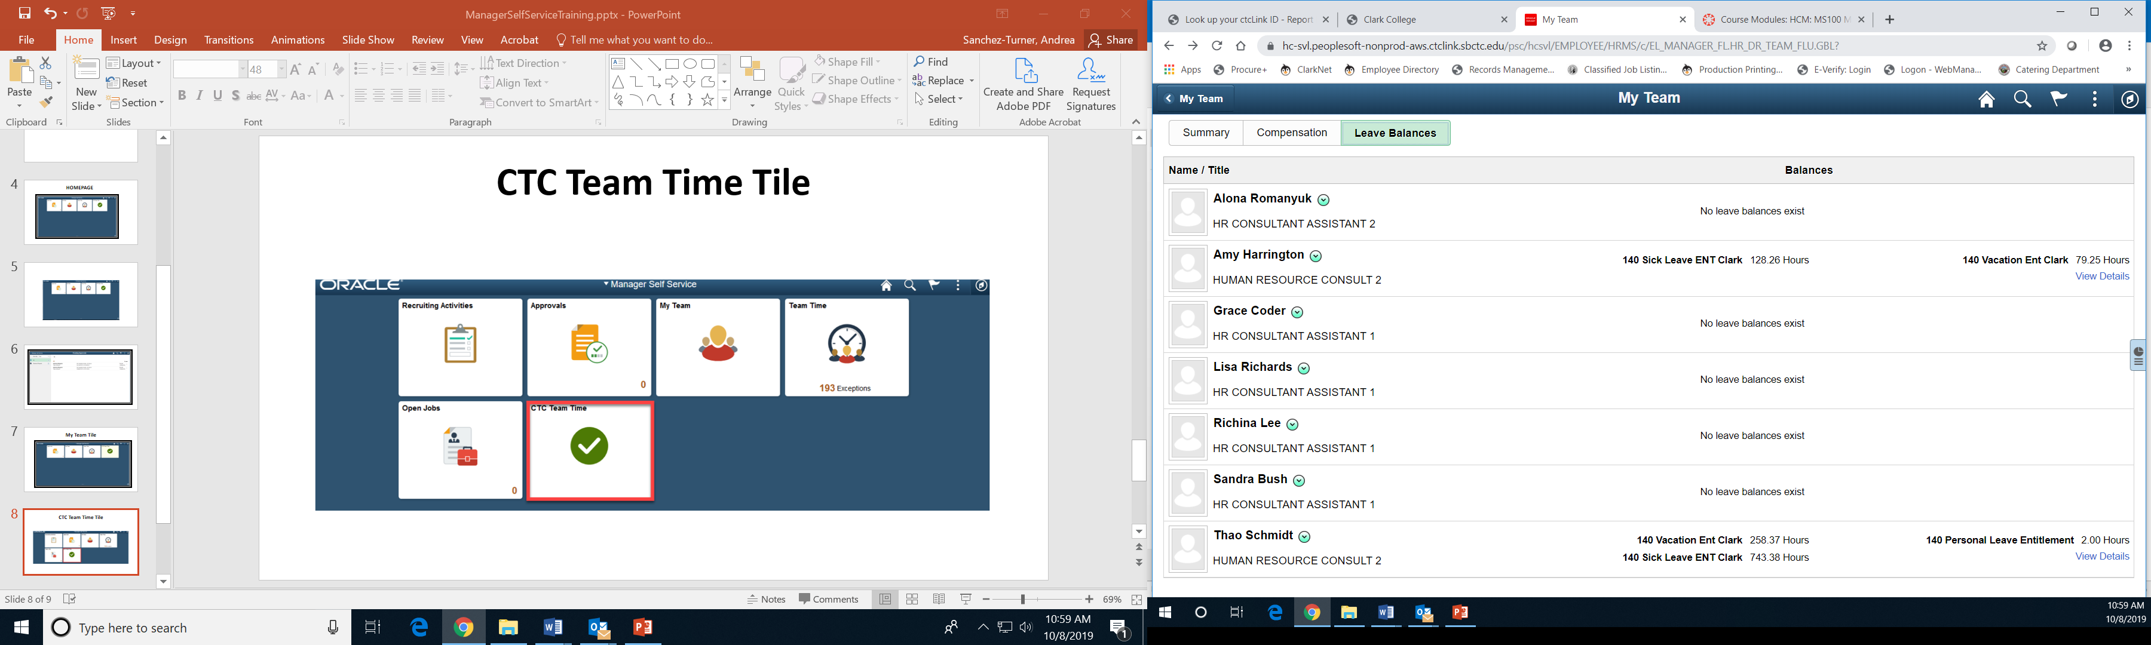

Slide 8
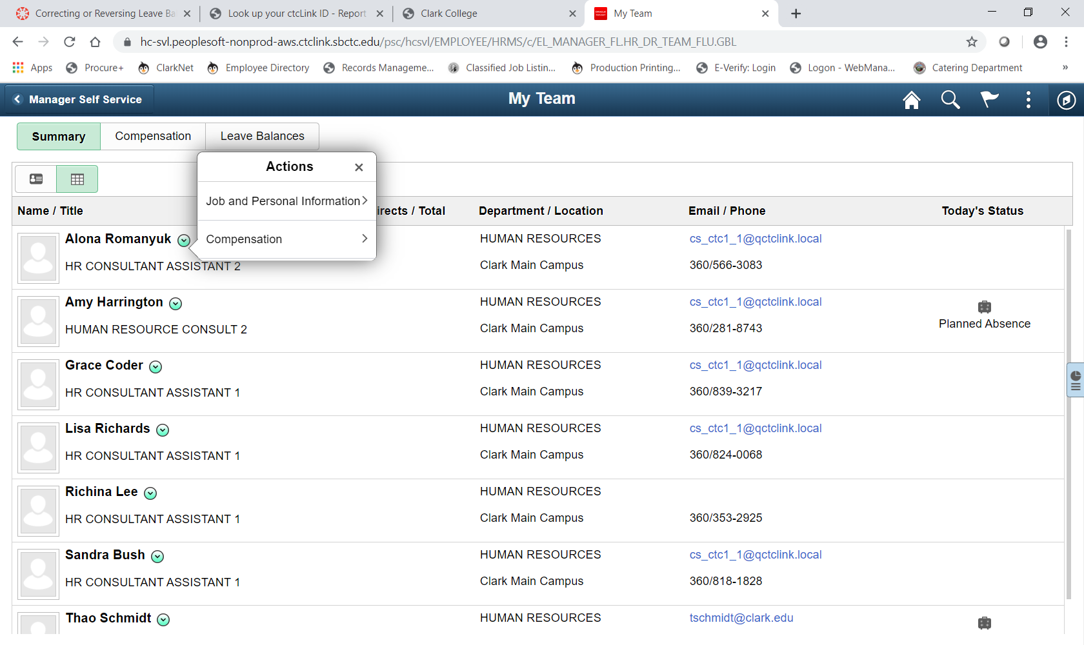

Slide 9
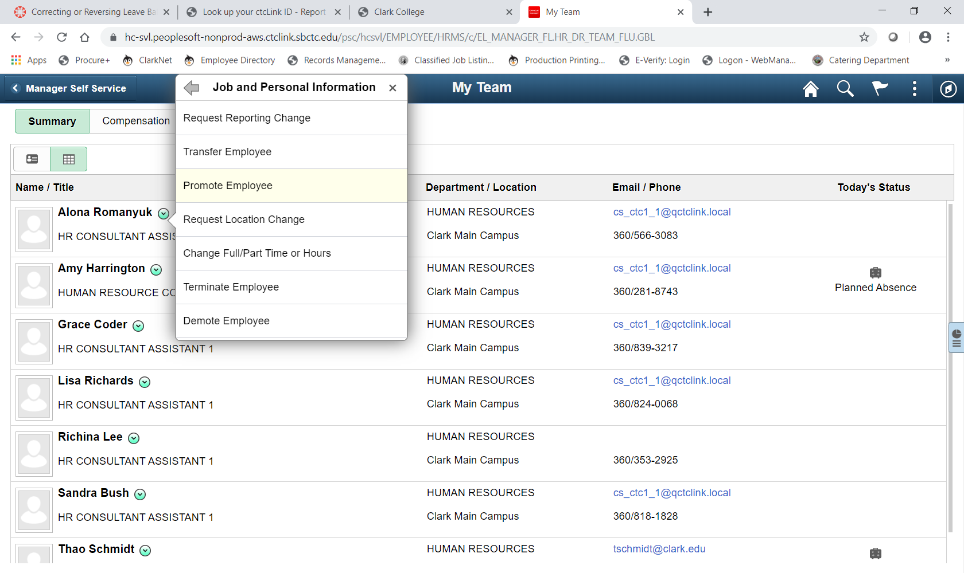

Slide 10
Team Time Tile

Slide 11
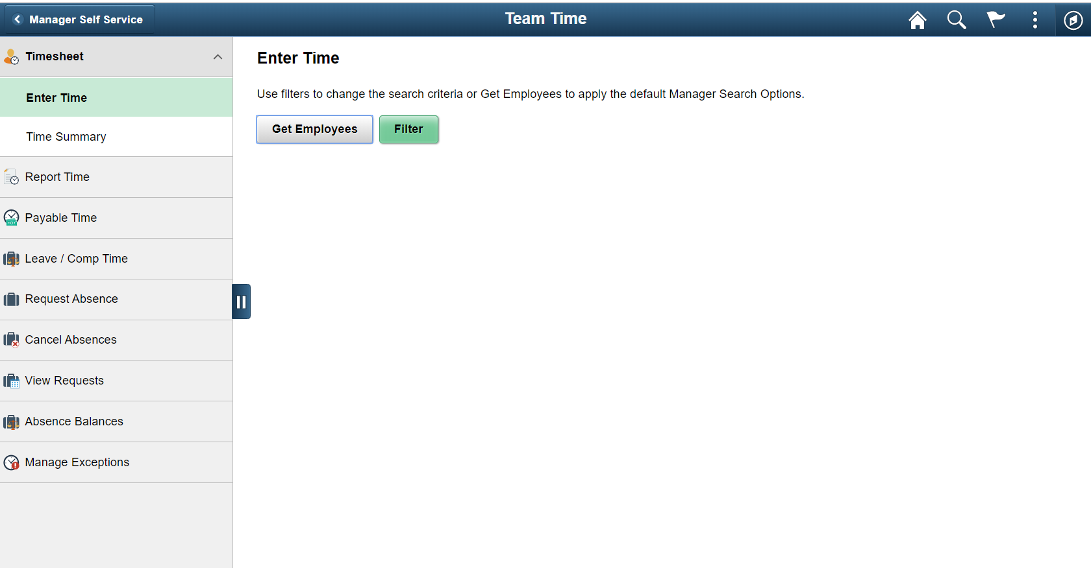

Slide 12
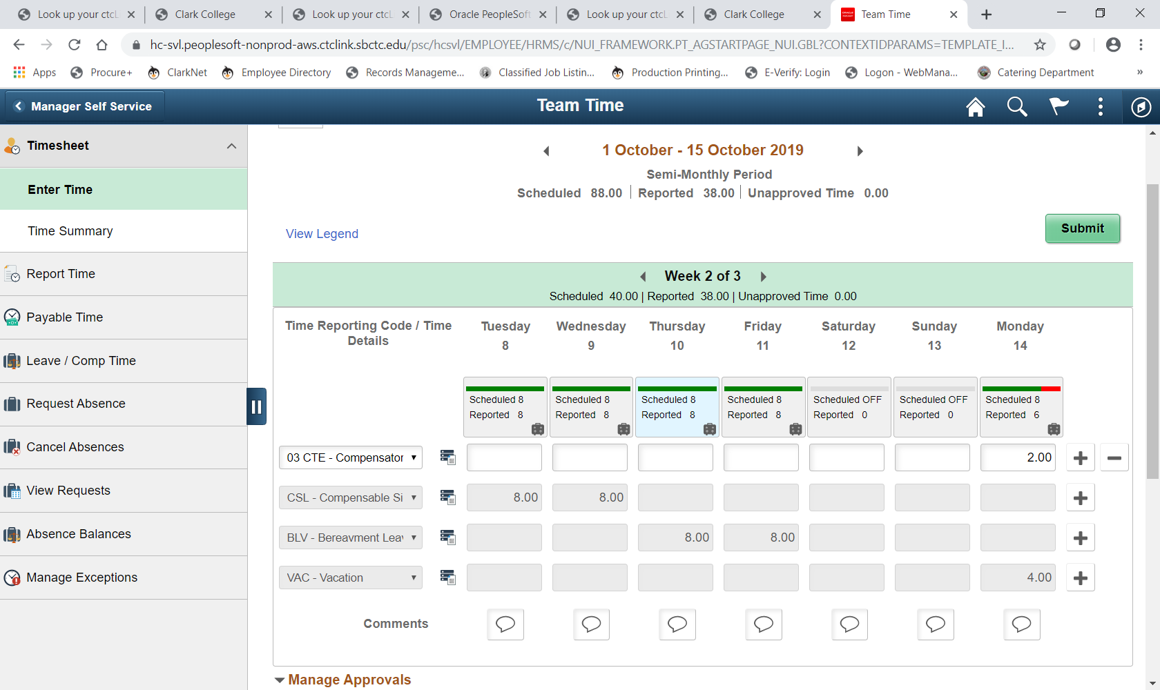

Slide 13
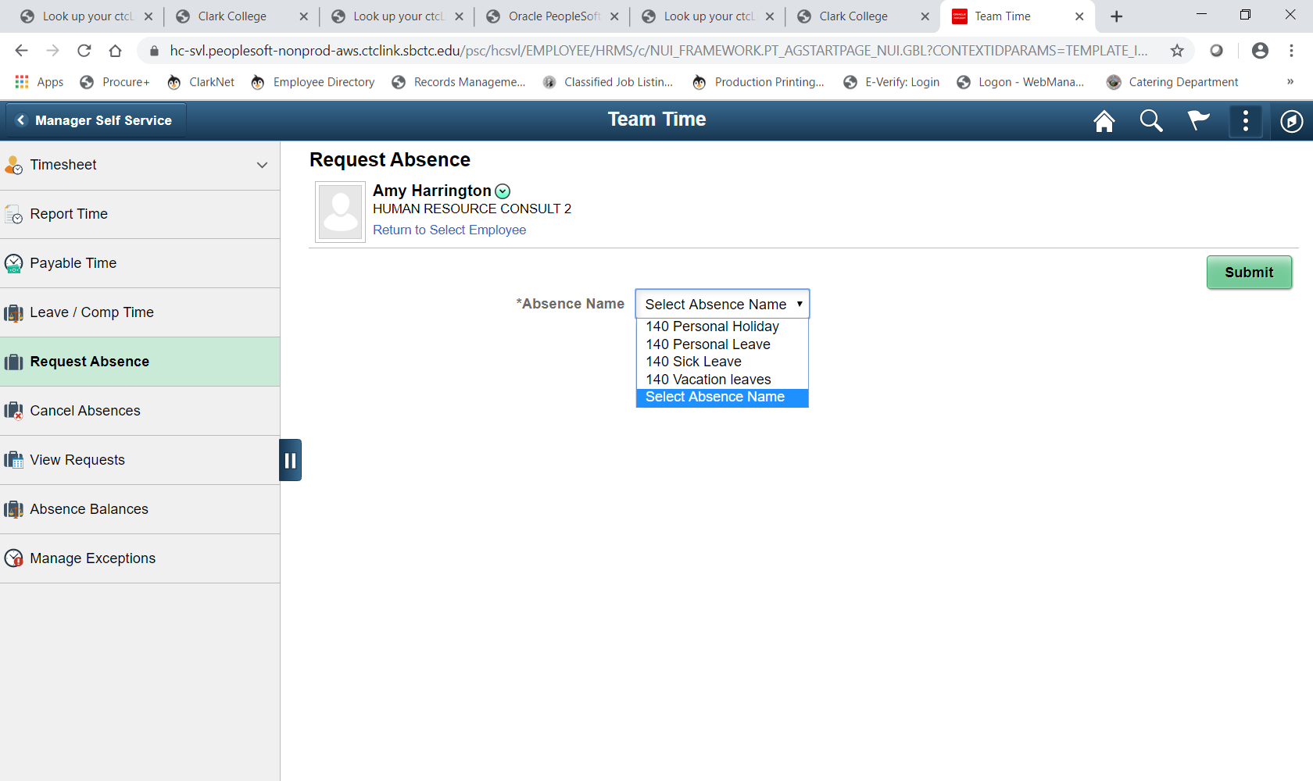

Slide 14
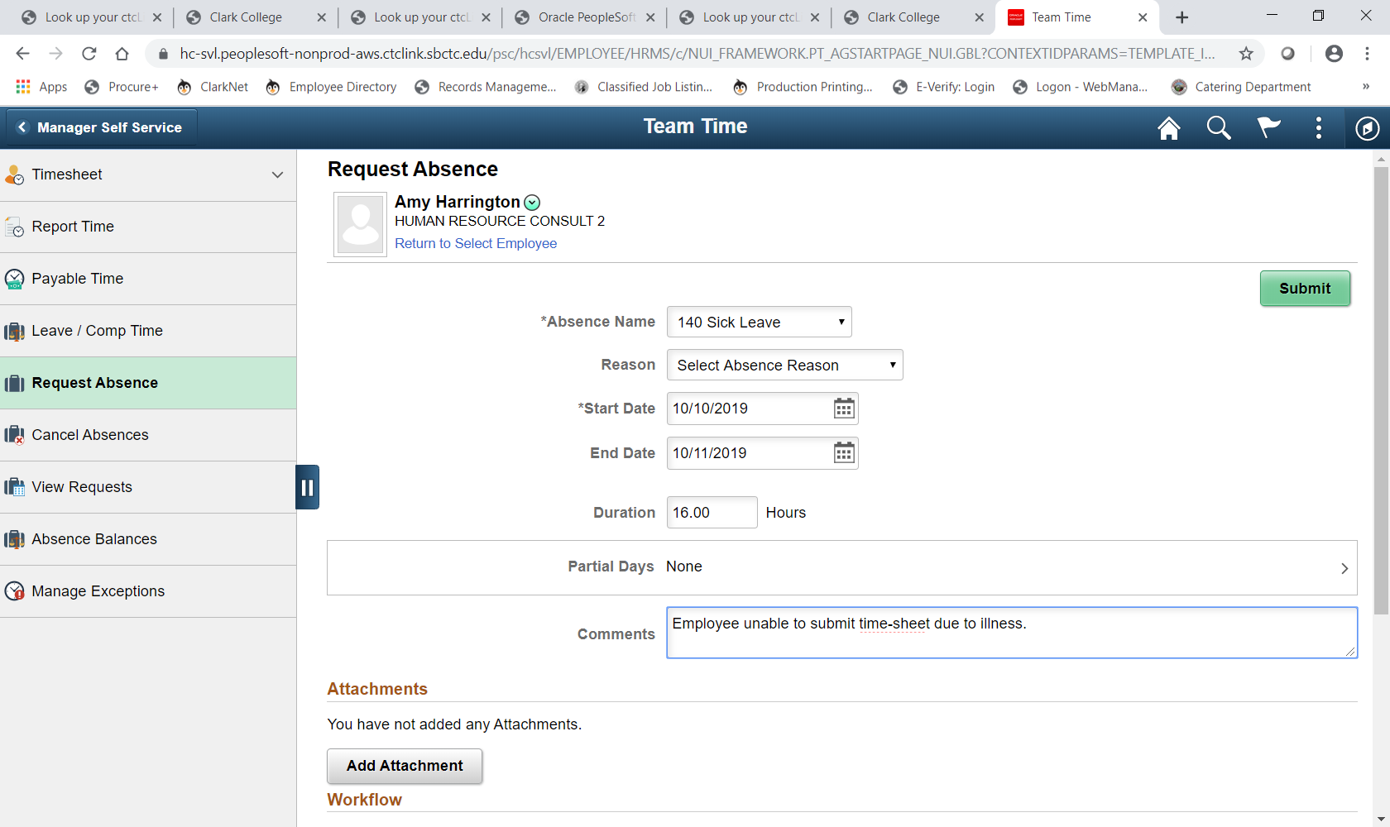

Slide 15
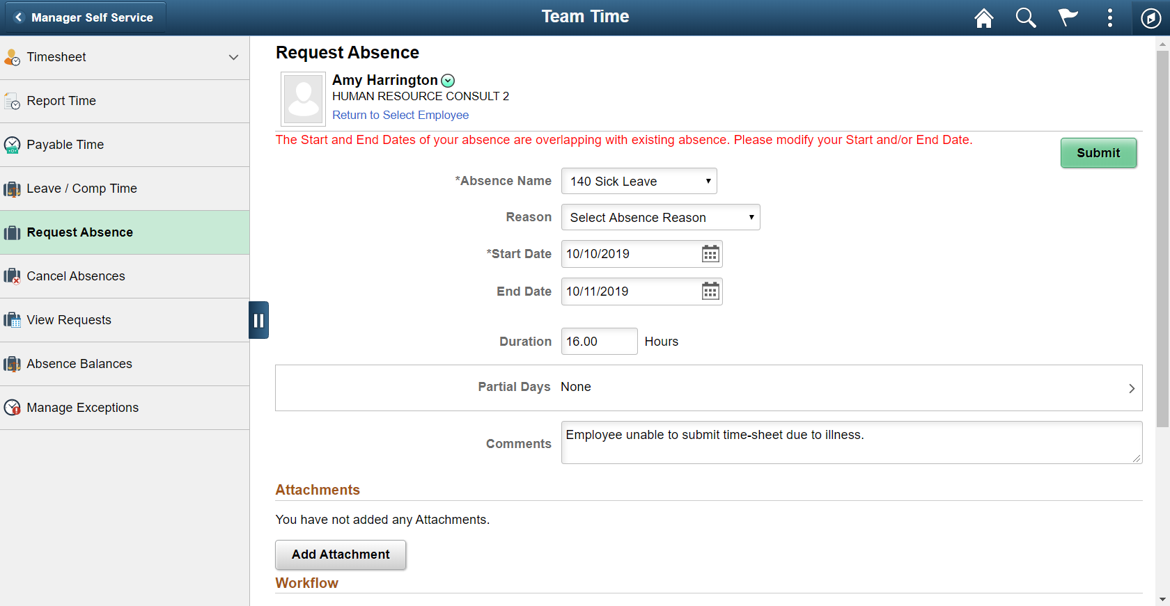
11

Slide 16
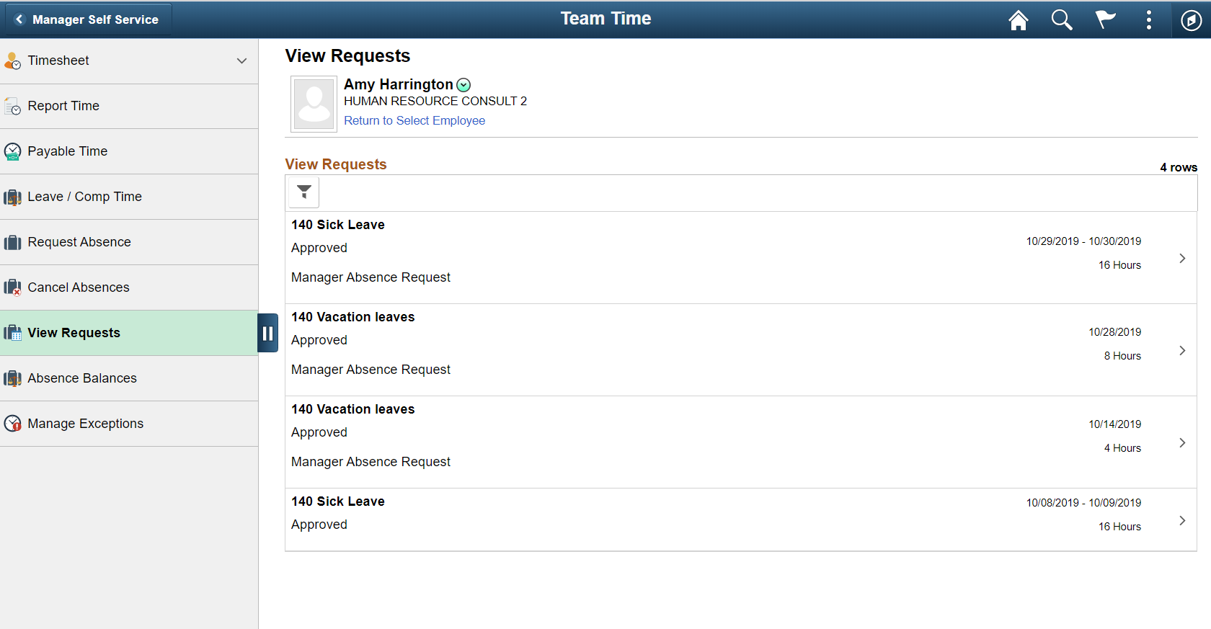

Slide 17
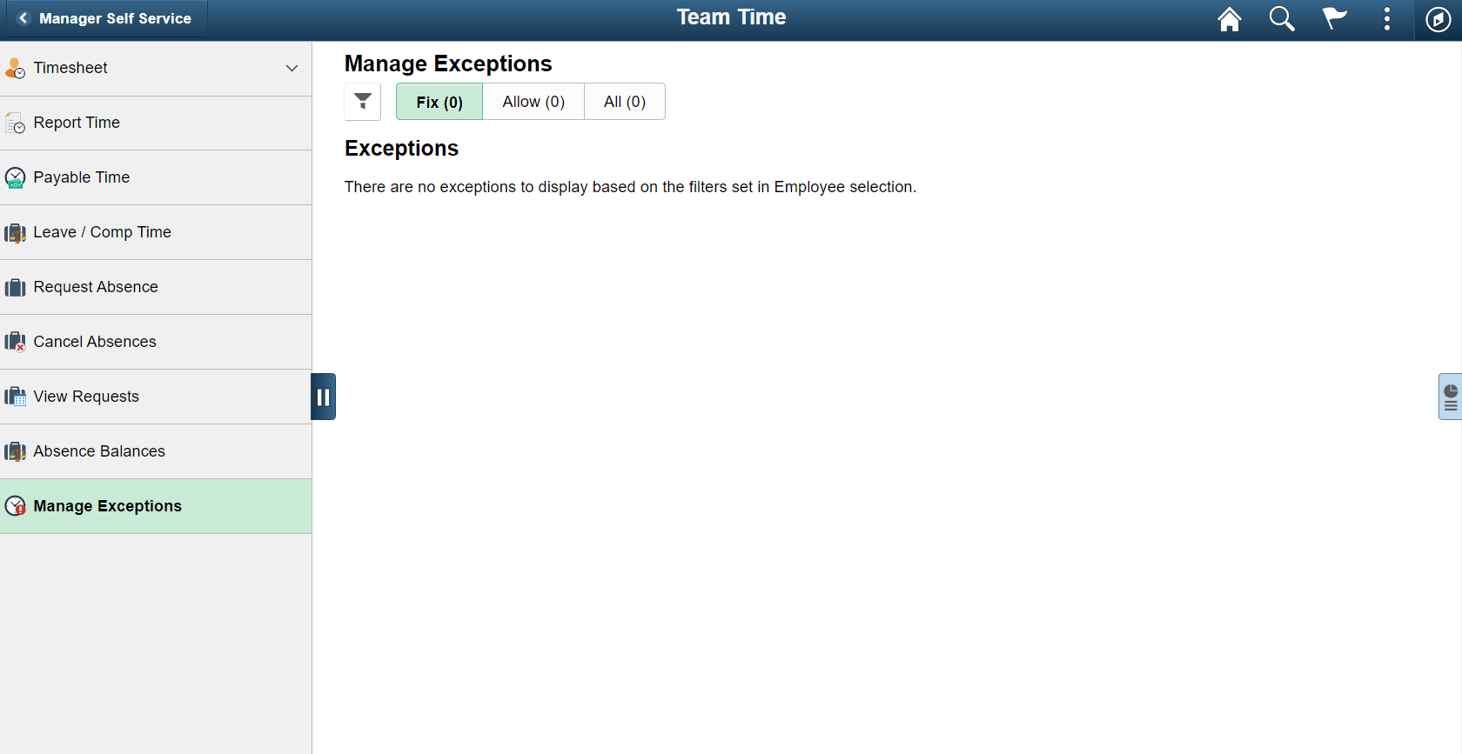

Slide 18
CTC Team Time Tile

