Slide 1
Allied Health & Nursing -
Information Session

Slide 2

Things We Will Cover
Some of the Allied Health & Nursing programs with limited enrollment
The application process for limited enrollment programs
Where to find program information
Program requirements
Educational planning tips
And more

Slide 3
Limited Enrollment Programs
We will cover these programs:
  Medical Assistant (MA)
  Medical Laboratory Technology (MLT)
  Nursing
Admission to these programs is competitive
There are a lot of interested students, but not enough seats.
Those with the best grades accepted first.

Slide 4
Getting Started
Look for information online
  Become familiar with your program’s website
  www.wvc.edu/alliedhealth
  Or, WVC Homepage → Learn → Degrees & Certificates → (your program of choice)
  Almost everything you need can be found online
    Prerequisites forms
    Program guides
    Program contacts
    And more
  Check regularly for updates and new info

Slide 5
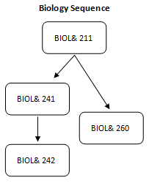
Getting Started Cont.
WVC students
  Start gathering info as soon as possible
  Review prerequisites (MLT → First-Year courses)
    Review course sequencing, especially important for
    Biology and Math
  Develop an educational plan
Additional step for students with transfer credits
  Request a Credit Evaluation, visit www.wvc.edu/TranscriptEvaluation for more information.
  Official transcripts must be on file with WVC. Unofficial transcripts may be used during an initial evaluation, but officials will be required.

Slide 6

Medical Assistant (MA)

Slide 7
What is a MA? What do they do?
Provide basic patient care
  Interview patients to obtain medical history
  Record vital signs
  Assist with patient examinations
  Administer medication and monitor patient responses
  Draw blood
Help with administration of the medical office
  Maintain medical records
  Schedule appointments
  Handle insurance and billing procedures

Slide 8
MA Prerequisites
One of the following:
  BCT 100 Basic Computer Keyboarding
  BCT 105 Computer Applications
  Documentation of computer literacy in Microsoft Office
  ENGL& 101Composition: General
One of the following:
  ENGL 97 Composition: Paragraph
  One year of high school English
One of the following:
  MATH 90 Basic Mathematics
  One year of high school algebra
  COMPASS placement into MATH 93 (or higher)
Continued …

Slide 9
MA Prerequisites Cont.
One of the following:
  PSYC& 100 General Psychology
  PSYC& 200 Lifespan Psychology
HLTH 123 Medical Terminology
Current Basic First Aid card
Current Health Care Provider CPR card

Slide 10
MA Applications
Apply when you have(a) met all the general requirements and (b) completed all the prerequisites.
Applications Accepted
High School Transcripts
Late June
Official transcripts from the last 10 years must be submitted
1-2 week window to apply
Program Info
Fall-start
4-quarter program (evenings & Saturdays)
You may be allowed to omit old transcripts
College Transcripts
Official high school transcript must be submitted
Or, submit official GED transcript

Slide 11
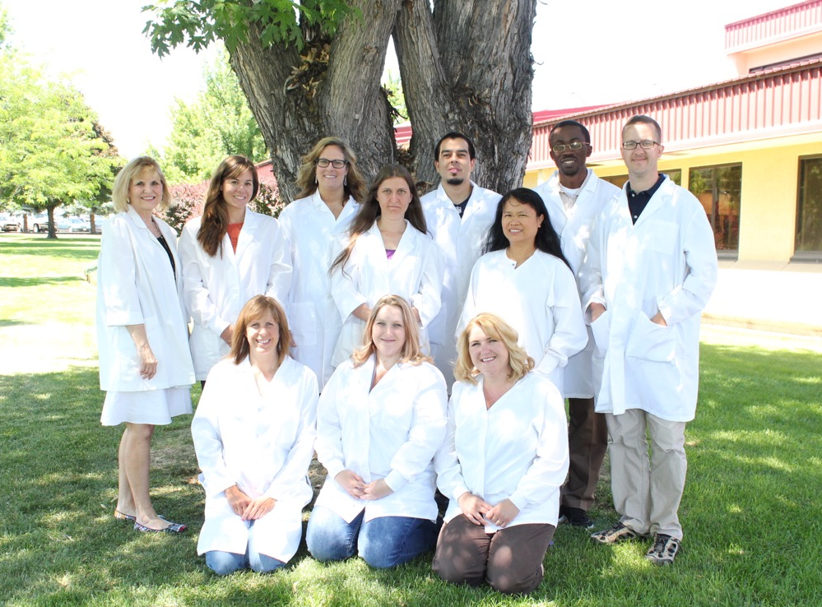
Medical Laboratory Technology (MLT)

Slide 12
What is an MLT? What do they do?
Assist in diagnosing, monitoring, and treating diseases
Collect, process, and analyze blood samples
Perform testing on blood and body fluid samples
  Examine fluids microscopically
  Examine cultures for the presence of bacteria
  Analyze blood for the presence of antibodies
Perform blood bank testing
Perform drug testing
Maintain and repair laboratory instrumentation

Slide 13

MLT Locations
Multiple sites throughout Washington and parts of Idaho and Oregon.
Check the MLT website for current locations.

Slide 14
MLT First-Year Courses*
MATH 099 Intermediate Algebra or placement into college-level math
CHEM& 121 Intro to Chemistry
CHEM& 131 Intro to Organic/Biochemistry
BIOL& 241 Human Anatomy & Physiology 1
BIOL& 242 Human Anatomy & Physiology 2
BIOL& 260 Microbiology
ENGL& 101 Composition: General
One 5-credit Social Science course
One 5-credit Humanities course
HLTH 123 Medical Terminology
MLT 100 Intro to MLT
MLT 102 Phlebotomy

Slide 15
MLT Applications
Apply when you have(a) met all the general requirements and (b) are done with or are 1 quarter away from completing all first-year courses.
Applications Accepted
Transcripts
Sites
Late March/ early April
Official transcripts from the last 10 years must be submitted
1 week window to apply
Multiple sites
(you can rank your choices)
Distant sites may require additional application information
Program Info
Summer-start
5-quarter program
You may be allowed to omit old transcripts

Slide 16

Nursing

Slide 17
What is a Nurse? What do they do?
Perform physical exams and gather health histories
Provide health counseling and education
Administer medications and wound care
Interpret patient information
Coordinate care in collaboration other healthcare professionals
Conduct research in support of improved practice and patient outcomes

Slide 18
Nursing Prerequisites
CHEM& 121 Intro to Chemistry
BIOL& 211 Majors Cellular
BIOL& 241 Human Anatomy & Physiology 1
BIOL& 242 Human Anatomy & Physiology 2
BIOL& 260 Microbiology
ENGL& 101 Composition: General
MATH& 146 Introduction to Statistics
PSYC& 100 General Psychology
PSYC& 200 Lifespan Psychology
Current Washington State NA‐C License (www.wvc.edu/CNA)

Slide 19
Nursing Corequisites
Communication Course
  Choose from ENGL 201, 202, 203 or 235
Humanities Courses (10 credits)
  Choose two 5‐credit courses from Art, Chicano Studies, Communications, English (literature, creative writing, poetry, or fiction), Humanities, Music, Philosophy, Theater Arts, or World Language.
    No more than one World Language course
    No more than one performance course.

Slide 20
Applications
Apply when you have(a) met all the general requirements and (b) completed all the prerequisites.
Applications Accepted
Transcripts and other requirements
Sites
June (Wenatchee and Omak)
Late fall (Wenatchee Only)
ALL official transcripts must be submitted
2 sites
(you can select a 1st and 2nd choice)
Program Info
Fall-start (Wenatchee and Omak)
Spring-start (Wenatchee only)
2 year program
Additional documents like TEAS scores and work experience need to be submitted.

Slide 21
General Info For
All Programs

Slide 22
Application Notes/Tips
Transcripts
  Must be official
  Must show all recent coursework
  International transcripts
Read websites thoroughly for additional info
  www.wvc.edu/alliedhealth
  Ask any questions before applications are due.
Late/incomplete applications will not be accepted
Registration tips
  What would you take if you are not accepted to your program? We recommend planning ahead and enrolling in those classes. If you are accepted to the program, you can drop those other classes.

Slide 23
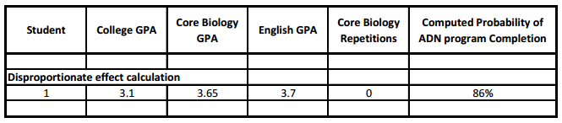
Acceptance
MA Program acceptance uses Cumulative GPA
MLT Program acceptance uses several grades to generate a Probability of Success Score
  Based on research of factors that predict completion/success
    GPA
    Core biology courses (BIOL& 241, 242, and 260)
    ENGL& 101

Slide 24
Nursing Program Acceptance
Nursing Program acceptance uses several factors including grades to generate score
  TEAS score
  Grades
    GPA and BIOL& 241, BIOL& 242, MATH& 146, and PSYC& 100.
  Healthcare Work experience
    CNA license and experience in the field.
  Other optional factors
    Military, WVC credits, international experience.
  Visit www.wvc.edu/Nursing, then go to the RN program and click on Nursing Program Evaluation and Selection for more information.

Slide 25
After Submitting
Applications
Notification
  Acceptance/denial notifications sent to everyone
  May be placed on a short-term waitlist. This waitlist only applies to the current application cycle and will not carryover to future applications.
If you are accepted
  Read acceptance packet and follow steps outlined. You will be required to pay an acceptance fee and complete paperwork.
May be assigned a new Faculty Adviser

Slide 26
Anticipated Expenses
Immunizations
Insurance
Background checks
Consider “Front loading” your student loans
  Talk to Financial Aid for more details, financialaid@wvc.edu or 509-682-6810.

Slide 27
Conviction of Crimes
Conviction of certain crimes may prevent completion of clinical course requirements of Allied Health program and may prevent future licensure and employment in healthcare.
Students with a criminal record should meet with the Dean of Allied Health or Director of Nursing NOW (509.682.6660) to determine if the criminal history would prevent access to a healthcare facility.

Slide 28
Contact Information
Found online:
www.wvc.edu/alliedhealth

